Slide 1
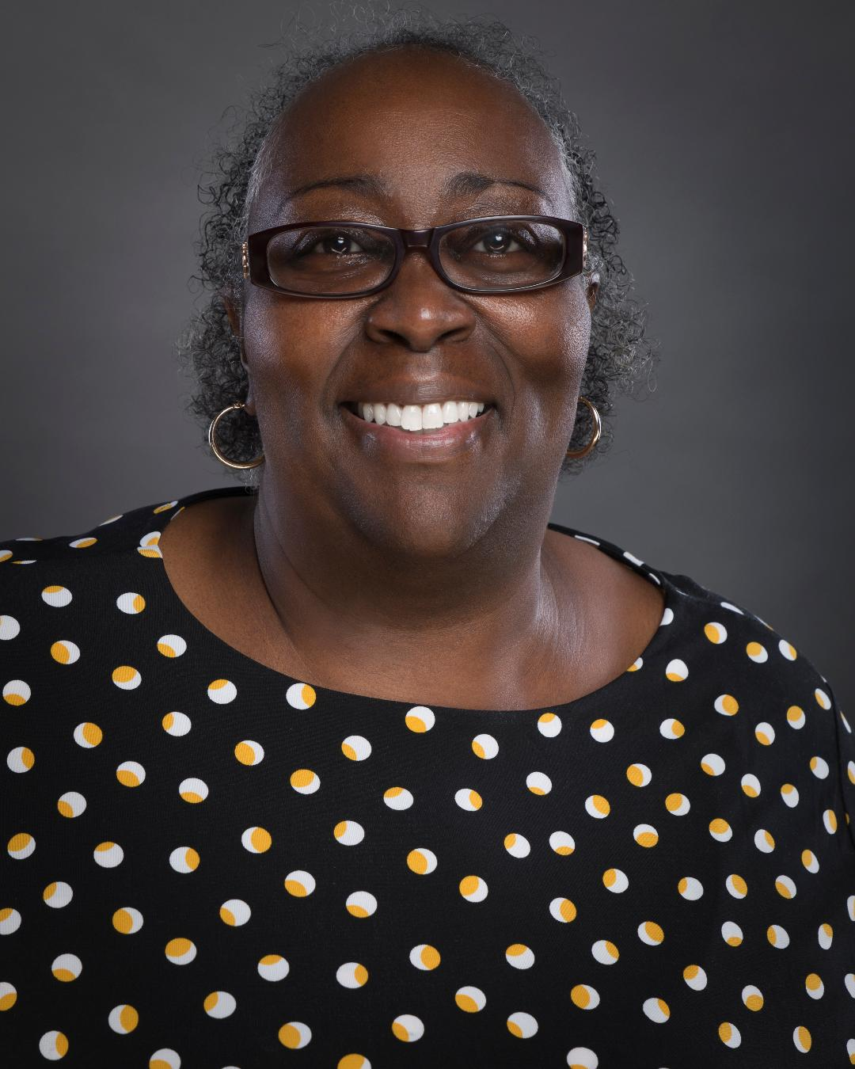
Abby L. Vandiver #Own Voices-Creating Diverse Characters! 9:00 AM EST
Abby L. Vandiver also writing as Abby Collette USA Today & Wall Street Journal Bestselling Author
A DEADLY INSIDE SCOOP Order here: bit.ly/ScoopPRH
Buy links: https://www.penguinrandomhouse.com/books/612899/a-deadly-inside-scoop-by-abby-collette/ Find Me Here:
Twitter: www.twitter.com/abbyvandiver Instagram: www.instagram.com/abbylvandiver Website: www.abbyvandiver.com Amazon: bit.ly/myamzpg

Slide 2
Hank Phillippi Ryan “Great Beginnings: Perfecting First line, First page, First Chapter” 11:00 AM EST
Watch for THE FIRST TO LIE 8/4. PW STAR! "Stellar."
http://www.HankPhillippiRyan.com
Mary Higgins Clark, Anthony, and five-time Agatha Award winner
THE MURDER LIST USA Today Bestseller
For personalized copies of any of Hank’s books, to you or to anyone else as a gift, or with any inscription you want, here’s a way to get them!
Go to Page 158 Books here: https://www.page158books.com/book/9781250258809 and use the code HANK for free shipping. You can put whatever personalization you want in the comment field.
And the personalized books will be shipped free to you (or whomever you’re gifting) instantly.

Slide 3
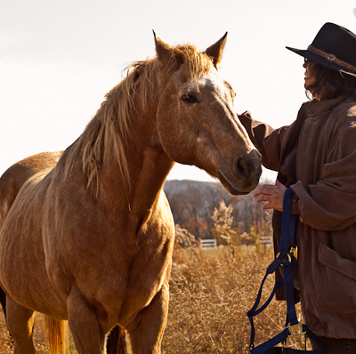
Jaden Terrell “Marketing for Writers Who Hate Marketing” 1:00 PM EST
Website: https://jadenterrell.com
Facebook Author Page: https://www.facebook.com/JadenTerrellAuthor
Twitter Handle: @JadenTerrell
Spirit of Ink FB writers' community: https://www.facebook.com/groups/spiritofink
Online courses: https://jaden-terrell-academy.thinkific.com/
Books:
Racing the Devil - Book One of the Jared McKean private detective series https://www.jadenterrell.com/books/racing-the-devil/
Trouble Most Faire - a cozy black cat detective romantic mystery
https://troublecatmysteries.com/jaden-terrell/

